Slide 1

How can TCPro help you?
You can extrapolate immunogenicity risk analyses to very large cohorts with diverse allelic distributions.
You can quickly evaluate relative immunogenicity risk in your deimmunization projects.
You may obtain TCPro from https://github.com/FDA/TCPro
Email: osman.yogurtcu@fda.hhs.gov
Notes:
There are two key potential use cases for TCPro.

Slide 2
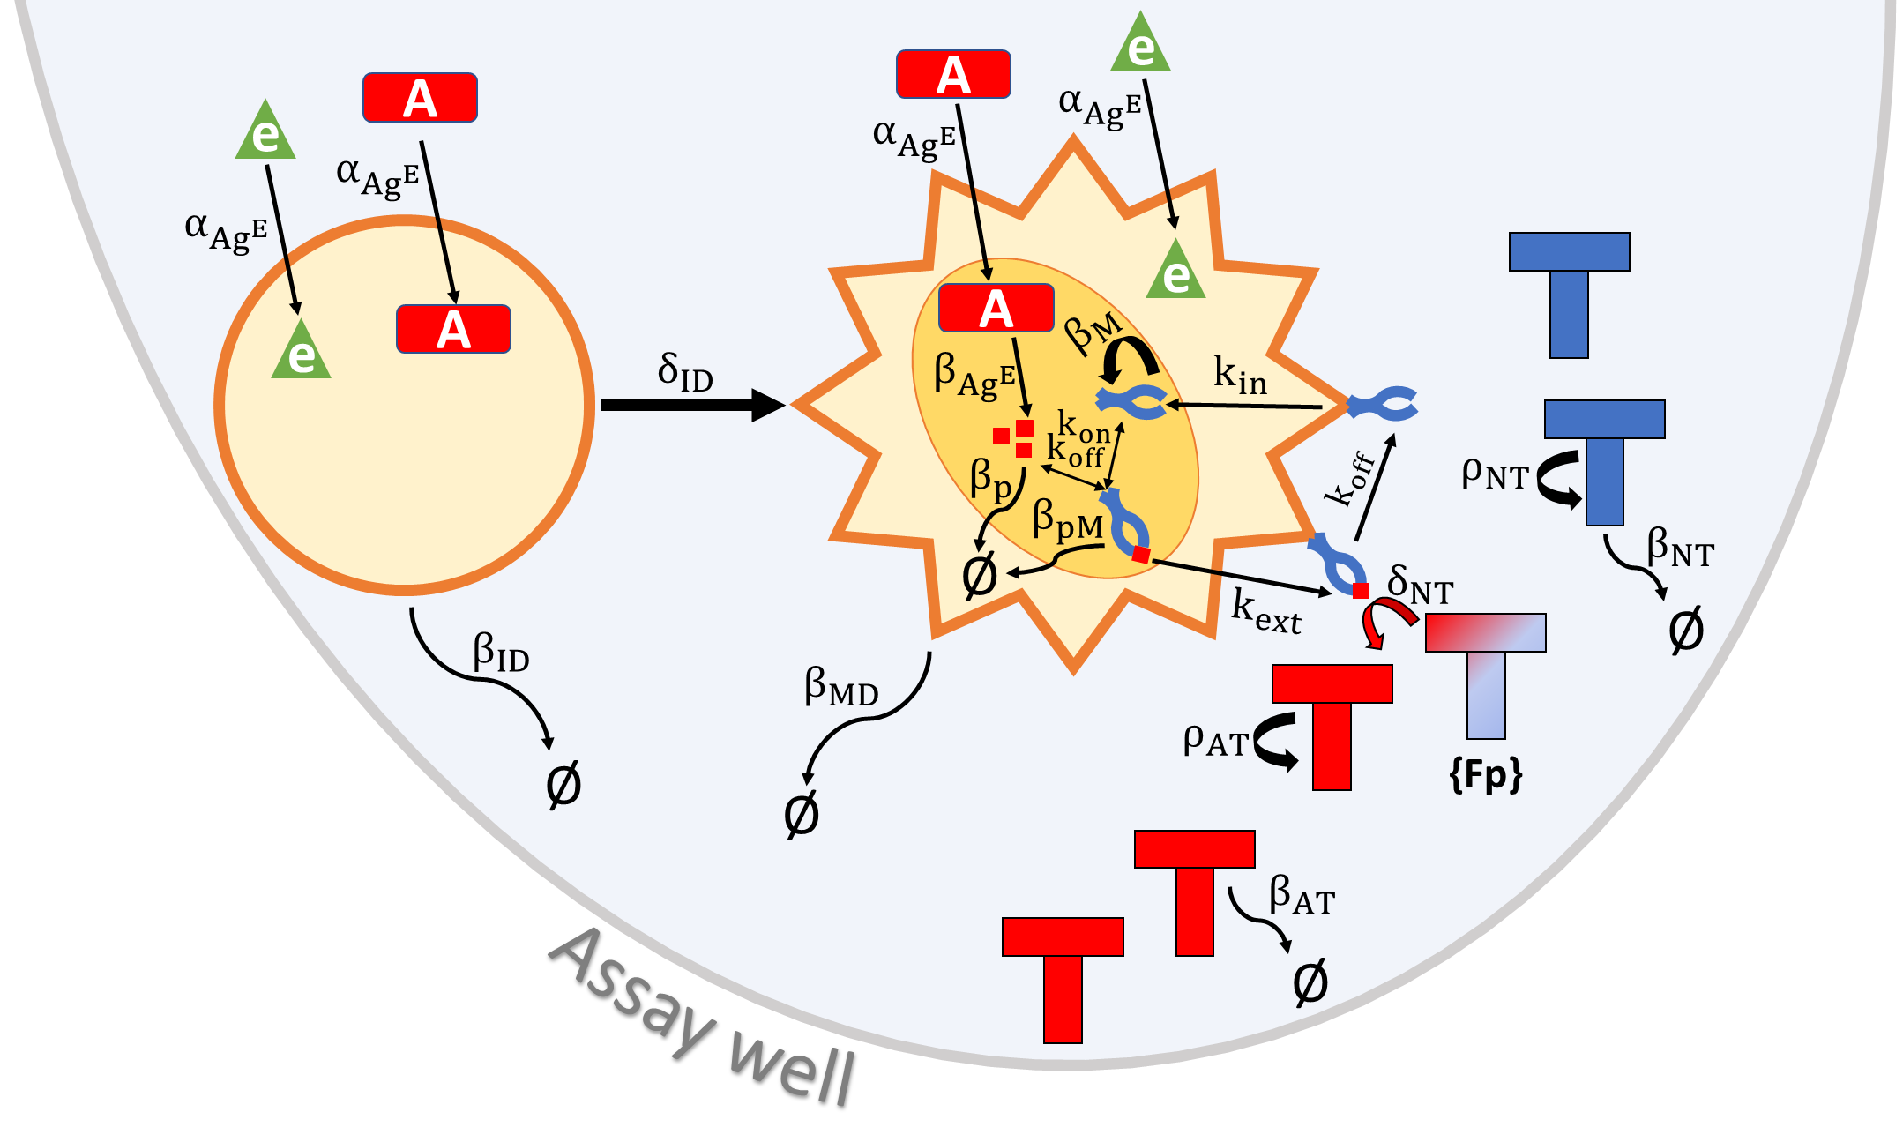
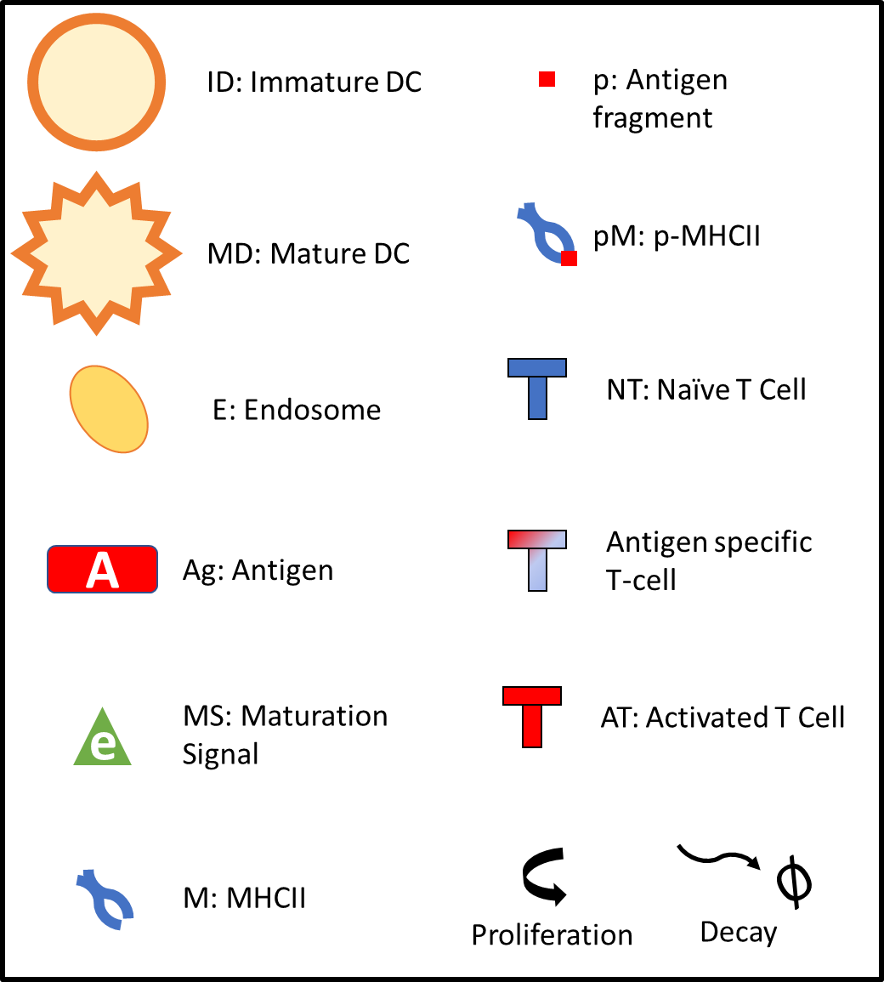
Modeling PBMCs in an Assay Well
Notes:
So, here is a schematic on how TCPro models the reactions in an ex vivo assay well.
Overall, we modelled the mechanisms of immune cell activities using Nonlinear Ordinary Differential Equations
And the model parameters were obtained from published in vitro data and typical immunogenicity ex vivo assay protocols.
Now let me explain these in more detail.

Slide 3
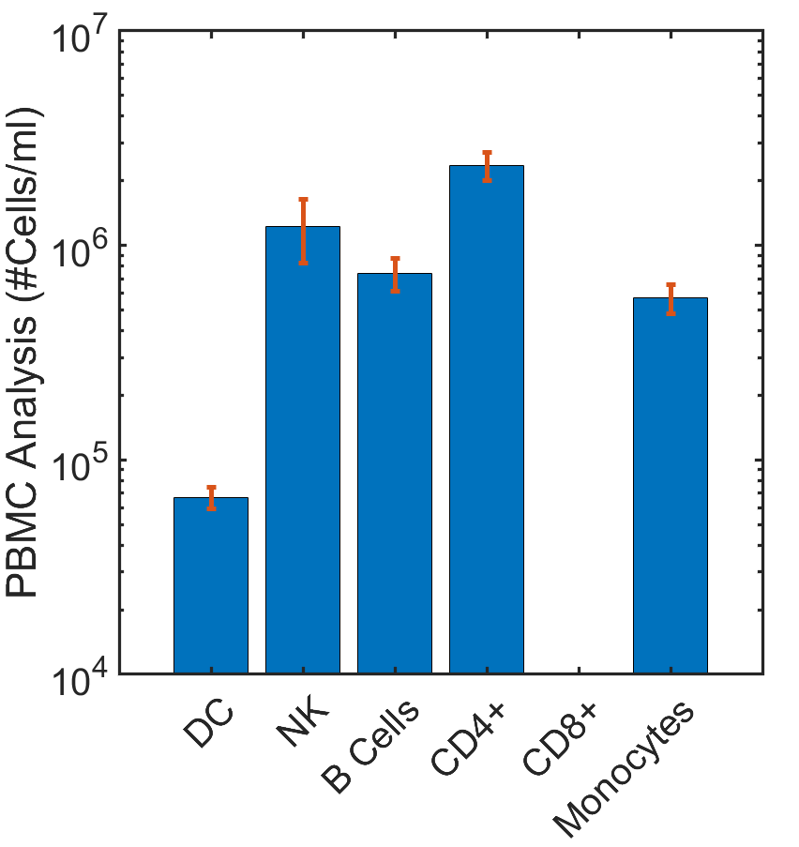
PBMC Types and Cell Fate Modeling in a Well
Numbers of different cell types in an assay well are randomly selected for each cohort member.
We model only the dendritic cells and CD4⁺ cells.
Cells can die or divide.
Autissier P, Soulas C, Burdo TH, Williams KC. Evaluation of a 12‐color flow cytometry panel to study lymphocyte, monocyte, and dendritic cell subsets in humans. Cytometry part A. 2010;77(5):410-9.
Notes:
First, we got the typical ranges for the counts of different cells in PBMC from a flow-cytometry paper.
The numbers of different PBMC types in an assay well are randomly selected for each virtual cohort member.
We model only the dendritic cells and CD4⁺ cells.
Cells can die or divide.

Slide 4



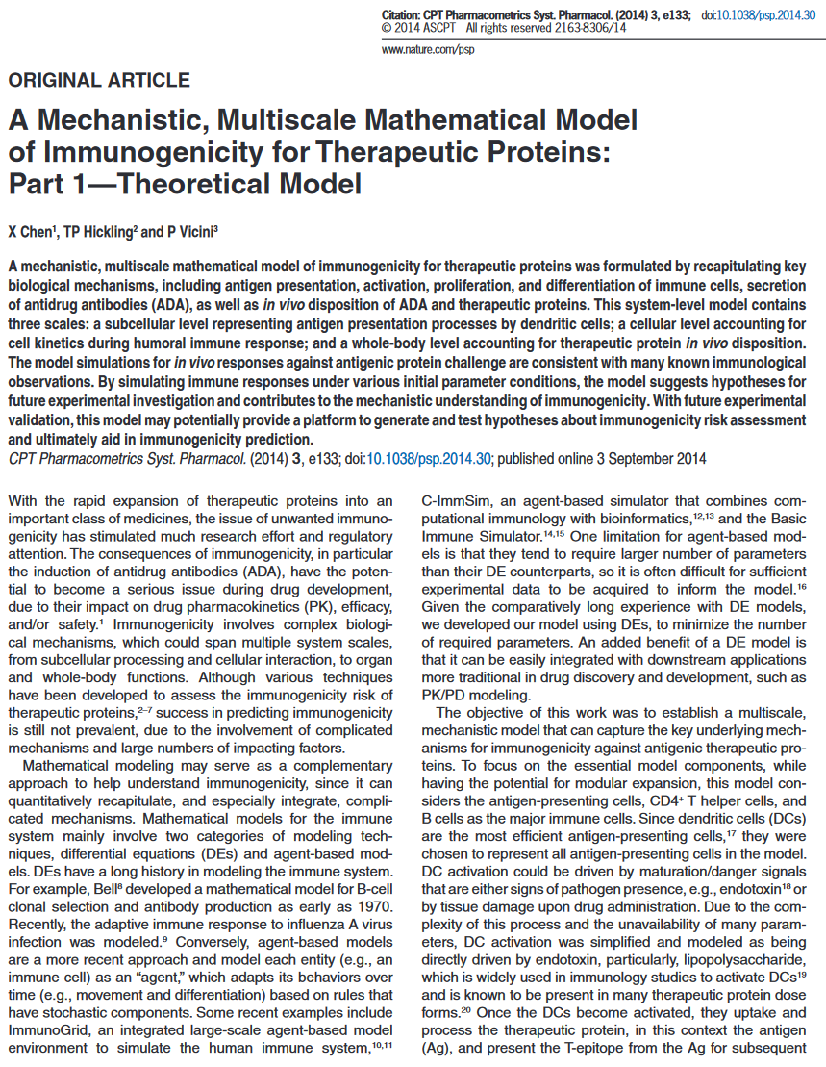
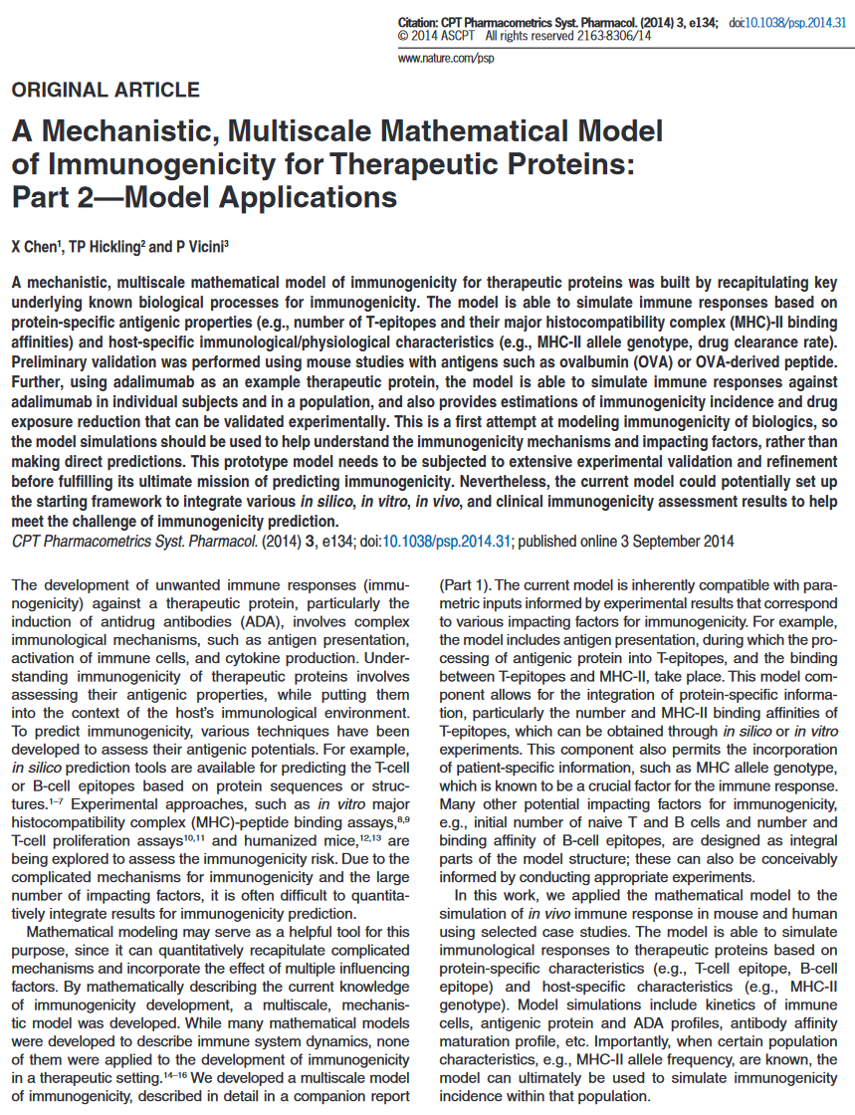
Chen Model Heavily Influenced The Antigen Presentation Mechanism in TCPro
Xiaoying Chen
Tim Hickling
Paolo Vicini
Standing on the shoulders of giants
Notes:
With this opportunity, I’d like to give a quick shout out to the developers of the Chen model, because the majority of the antigen presentation mechanisms in TCPro is derived from the ideas from their work. If it wasn’t for their code availability, wonderful documentation and their helping hand at a couple of meetings, I wouldn’t be here talking about TCPro today.

Slide 5
Antigen Presentation Modeling
In dendritic cells:
product molecules are endocytosed from the media,
antigenic product molecules are processed into shorter peptides,
short peptides can bind MHCII molecules or further degrade,
peptide-MHC complexes are presented on the membrane.
We assume that each 15-mer peptide of the product has an equal proclivity for cleavability out of the product.
We used NetMHCIIPan for peptide-MHC Class II molecule binding affinities.
We used IEDB and BLAST to calculate immunogenic propensity of each 15-mer peptide.
Improved methods for predicting peptide binding affinity to MHC class II molecules. Jensen KK, Andreatta M, Marcatili P, Buus S, Greenbaum JA, Yan Z, Sette A, Peters B, Nielsen M. Immunology. 2018 Jan 6.
Notes:
So, briefly the equations we have in TCPro model the following about the antigen presentation.

Slide 6
Cell Behavior Modeling
Immature dendritic cells differentiate into mature dendritic cells due to the maturation signal presence in the well.
Naïve T cells proliferate at a baseline level so long there are no product molecules in the assay well.
There are some T cells with frequency F_{p} that recognize product-derived peptides presented by MHC molecules.
When presented with those peptides, they differentiate into activated T cells.
Notes:
And here is a list of cell behaviors we modelled.

Slide 7
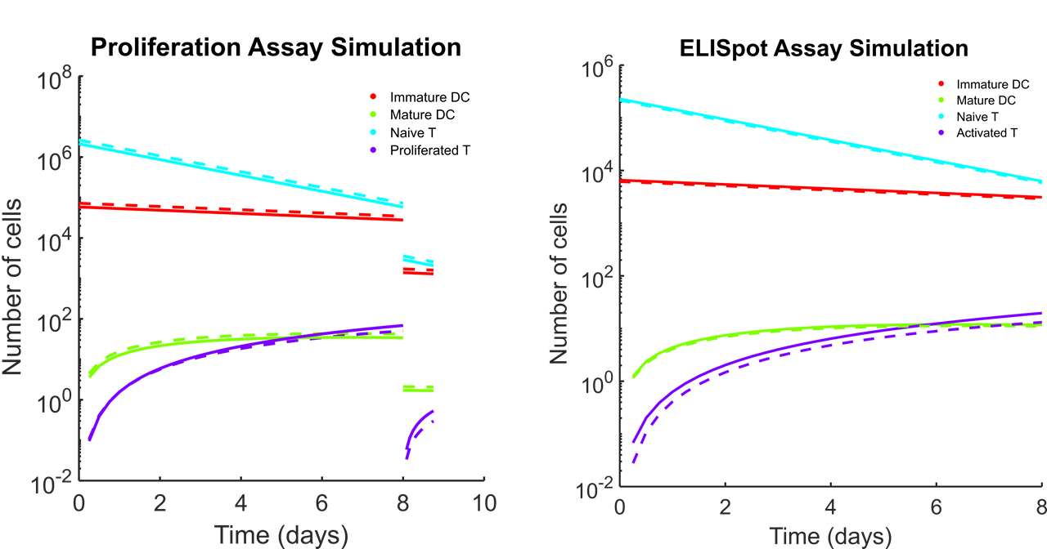
Example Cell Counts for the Two Assay Types
Notes:
TCPro makes projections for the cell counts in the proliferation assay and the ELISpot assay. We calculate stimulation indices based on the average ratio of the drug-responding cells (shown in solid) to the baseline (shown in dashed lines) at the last day of assaying (Day 8).

Slide 8
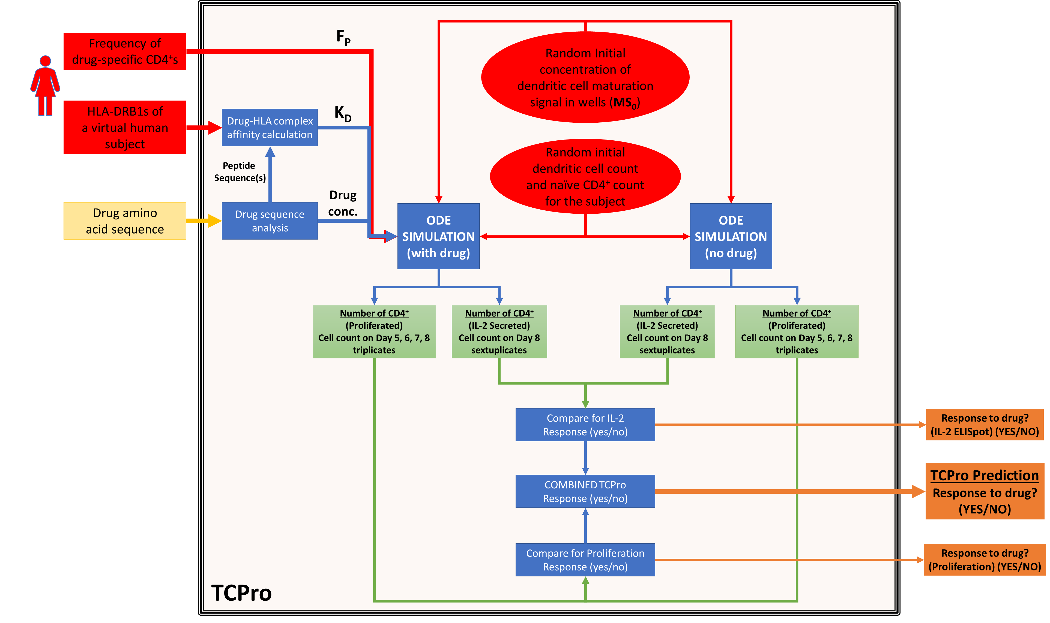
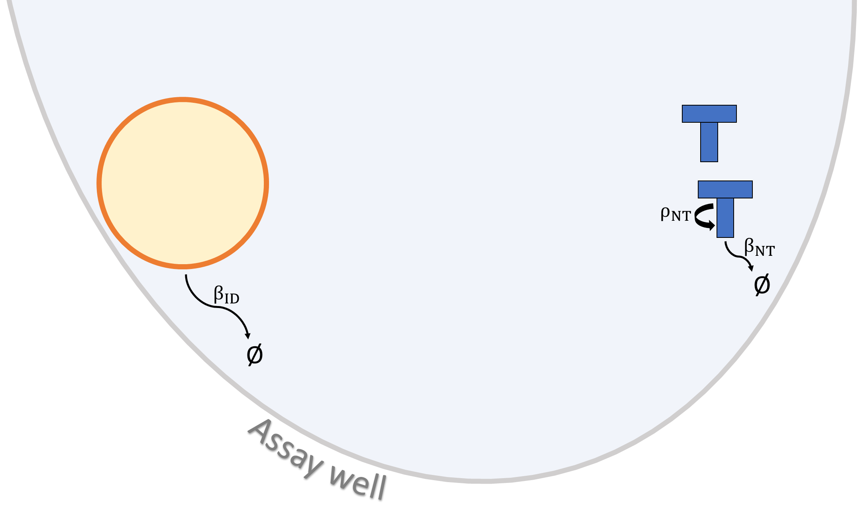
Overall Workflow for Modeling Patient A’s Immune Response to Drug B
Patient A
Drug B
vs
Notes:
Here is a schematic for the individual-level simulation workflow.
Using our mathematical model that describes an assay well, TCPro simulates the temporal dynamics of a patient’s helper T cells in artificial ex vivo assay wells in the presence and absence (baseline) of the biotherapeutic. By thresholding our stimulation index at 1.9, the workflow generates binary (yes/no) immunogenicity prediction for each individual much like the situation in the actual ex vivo assays.

Slide 9
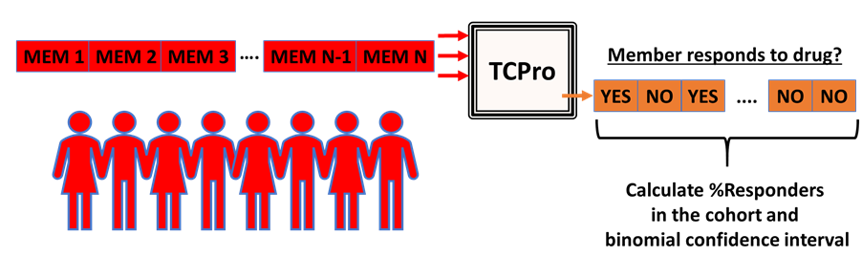
Predicting Immunogenicity Risk of a Patient Cohort with TCPro
Notes:
And at the population level, we simulate a number of virtual cohort members and calculate the percentage of those within the cohort whose cells are responsive to the drug that we used by way of evaluating the stimulation indices.

Slide 10
Sources of Variation in TCPro Predictions
Dendritic cell maturation signal initial concentration
PBMC type distribution in a person’s plasma
HLA set of a virtual cohort member
Product-specific CD4⁺ frequency in a person’s plasma
We run TCPro for each virtual cohort member 100 times and collect statistics.

